Slide 1
HOW TO RUN ECILIPSE ON SYSTEM

Slide 2
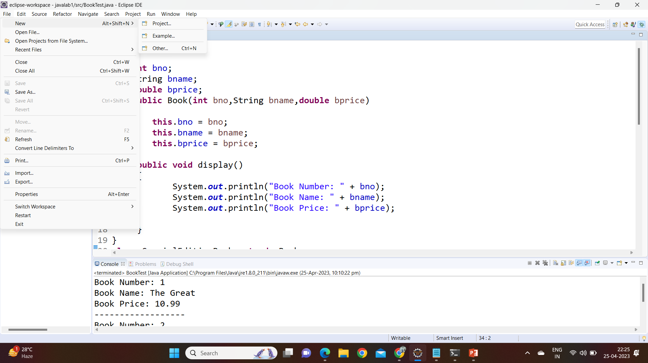
First open eclipse and left side corner there is a option “File” click on file and take “new” and after new there is option Project just click on it and create a new project file .

Slide 3
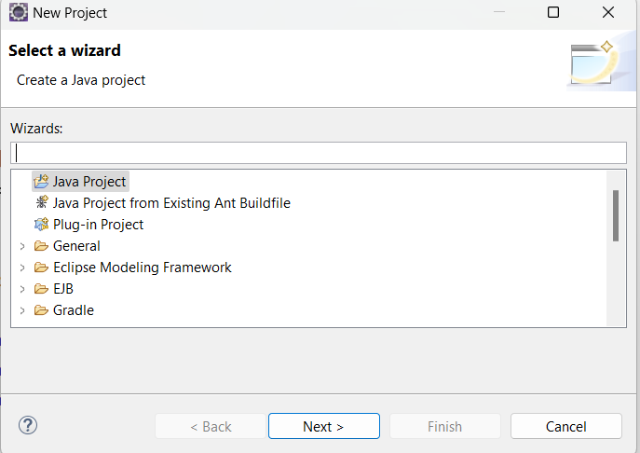
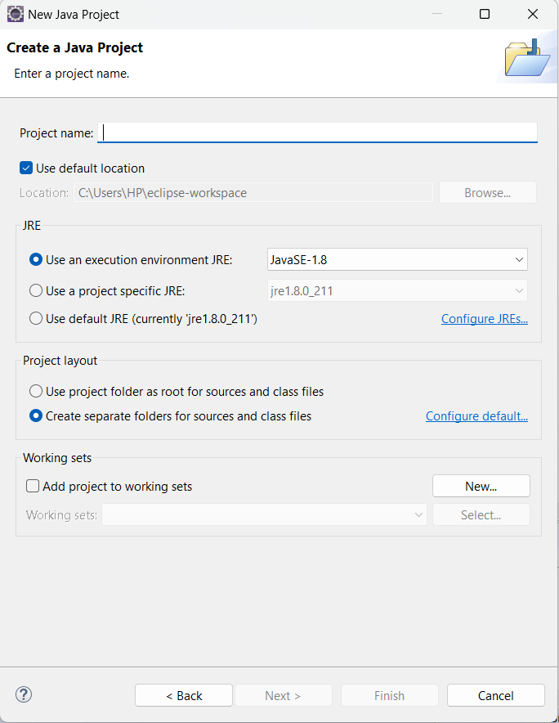
Click on project and you get a “wizard page “consists of different types of project names . just click on java project and create a new java project with name Javalab (based up on your own choice)

Slide 4
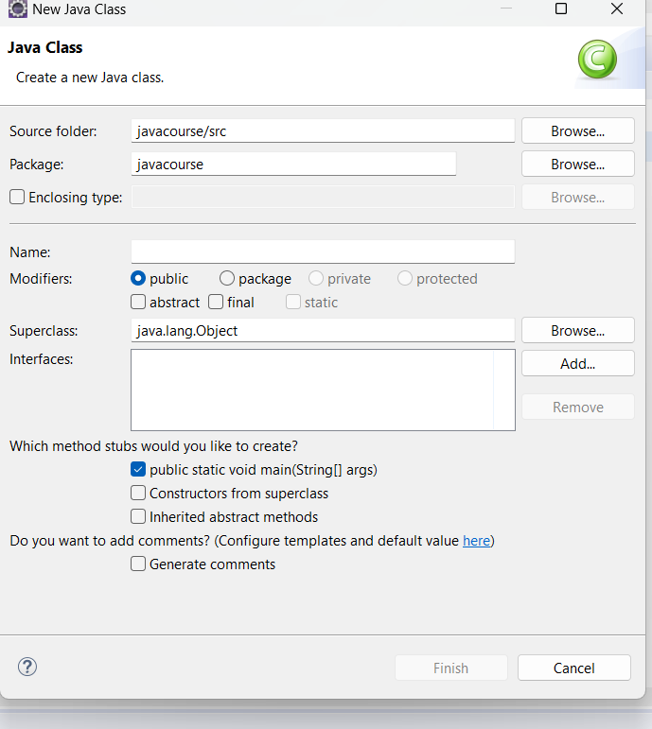
After completion of creating a new project left side corner there is a project name which was created by your own name and click on it you will get the file names like “jre system library” and “src” just right click on src it redirects to “new file” → “class”. You will get the class interface window like this. After that window in the name section enter your class name and click on finish.

Slide 5
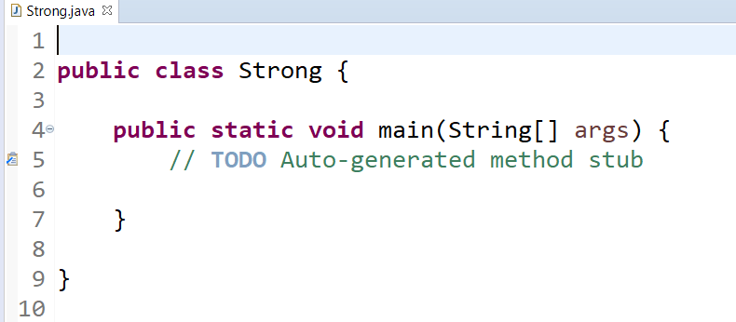
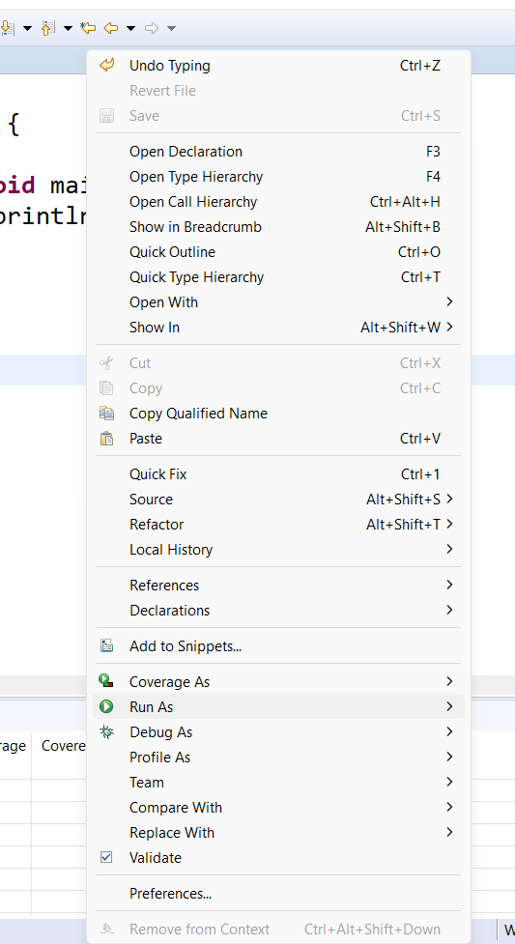
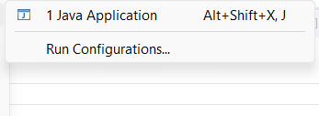
New class file was created with main method… type your code in that clkass file after completion of typing just use ctrl + s to save file and just right click on the class file → Run As → Java Application.

Slide 6
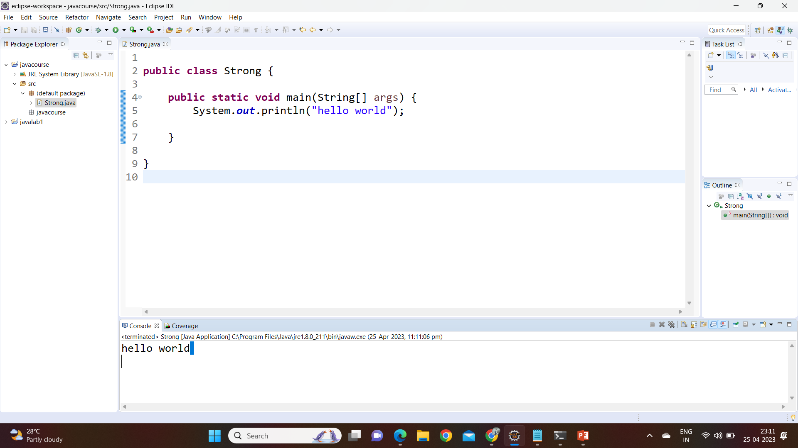
Code was executed and you will get the output in console window..

Slide 7
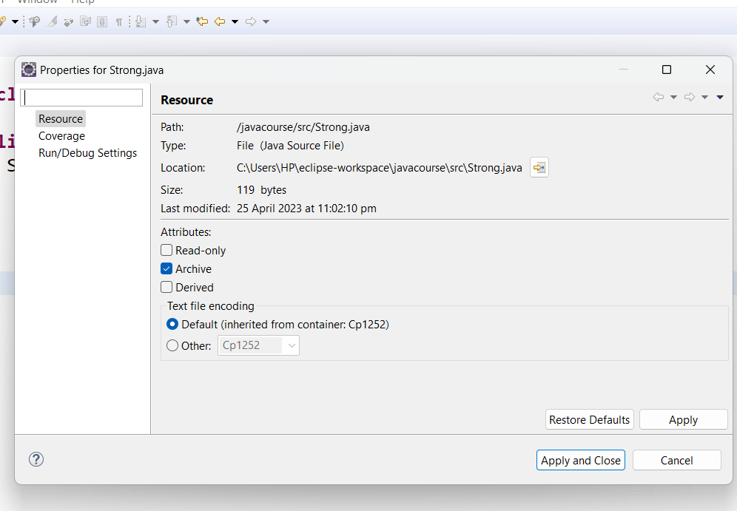
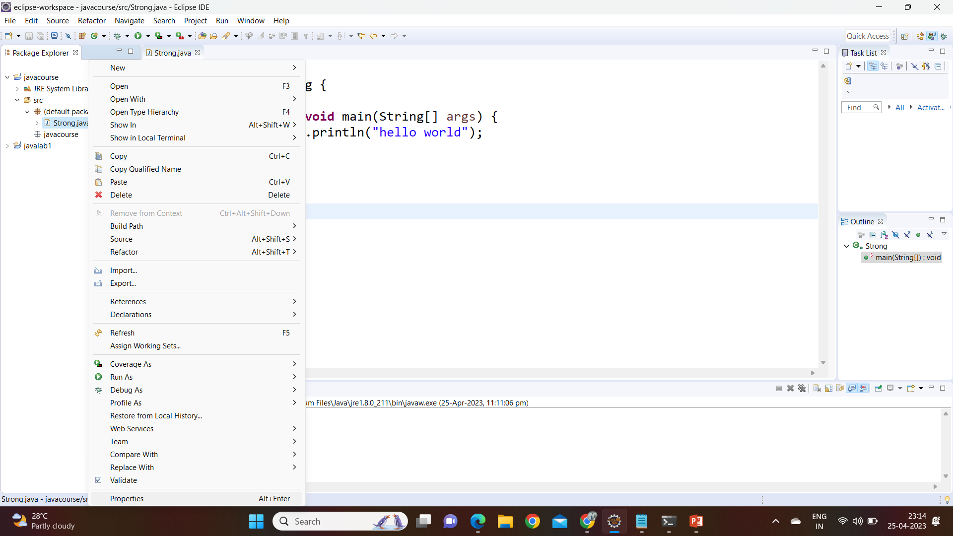
How to know the properties of a file and the file location in local drive. Just right click on class file in ecilipse and click on properties and you will get the interface with file path and extension of file etc..

Slide 8
ECILIPSE TO GITHUB

Slide 9
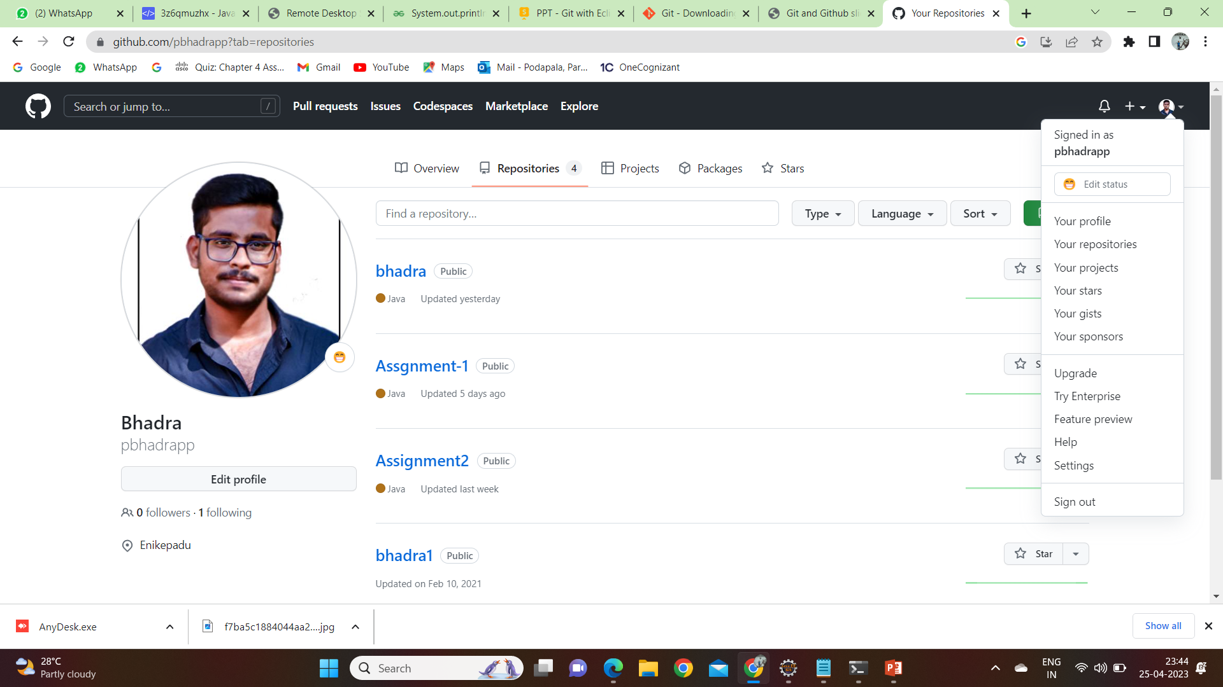
Create a git hub account using → https://github.com/ Creating a new account click on sign up and create a new account with your mail id Already existing account just click on sign in and enter your log in details to access the github account After log in click on profile shows in right side corner of web page

Slide 10
How to create a new repository in github
1) click on + option shows in right side corner of github account page.
2) click on new repository option and create a new repository with name and click on create option.
3) after completion of creation of new repository you need to enter some commands using that commands you need to push or pull the files in to your repository .

Slide 11
How to push or pull a files in to your github repository using eclipse…
1) first install github exe file https://git-scm.com/download/win
2) After completion of github setup in our system just go to the eclipse and right click on class file and click on properties. you will get the file path or file location of our class file in the local drive and than right click on the file location you will get the pop up on you screen consists of number of options just click on git bash here and then enter some commands to push or pull the files

Slide 12
Commands used to push a file
git config --global user.name “your user name"
git config --global user.email “your mail id"
git init
git add .
git commit -m " first commit by suresh"
git remote add origin https://github.com/suresh12/SureshTasks.git
git push -u origin master

Slide 13
commands used to clone
git config --global user.name "username"
git config --global user.email "email id"
git clone link
cd foldername/
git init
git status
git add .
git status
git commit -m "commit message"
git push -u origin master

Slide 14
Commands used to pull the files
git pull origin master
add some text inside the file
git init
git add .
git commit -m " second commit by suresh"
git push -u origin master

